Slide 1
Chapter 4: Threads & Concurrency

Slide 2
Chapter 4: Threads
Overview
Multicore Programming
Multithreading Models
Thread Libraries
Implicit Threading
Threading Issues
Operating System Examples

Slide 3
Objectives
Identify the basic components of a thread, and contrast threads and processes
Describe the benefits and challenges of designing multithreaded applications
Illustrate different approaches to implicit threading including thread pools, fork-join, and Grand Central Dispatch
Describe how the Windows and Linux operating systems represent threads
Design multithreaded applications using the Pthreads, Java, and Windows threading APIs

Slide 4
Motivation
Most modern applications are multithreaded
Threads run within application
Multiple tasks with the application can be implemented by separate threads
  Update display
  Fetch data
  Spell checking
  Answer a network request
Process creation is heavy-weight while thread creation is light-weight
Can simplify code, increase efficiency
Kernels are generally multithreaded

Slide 5
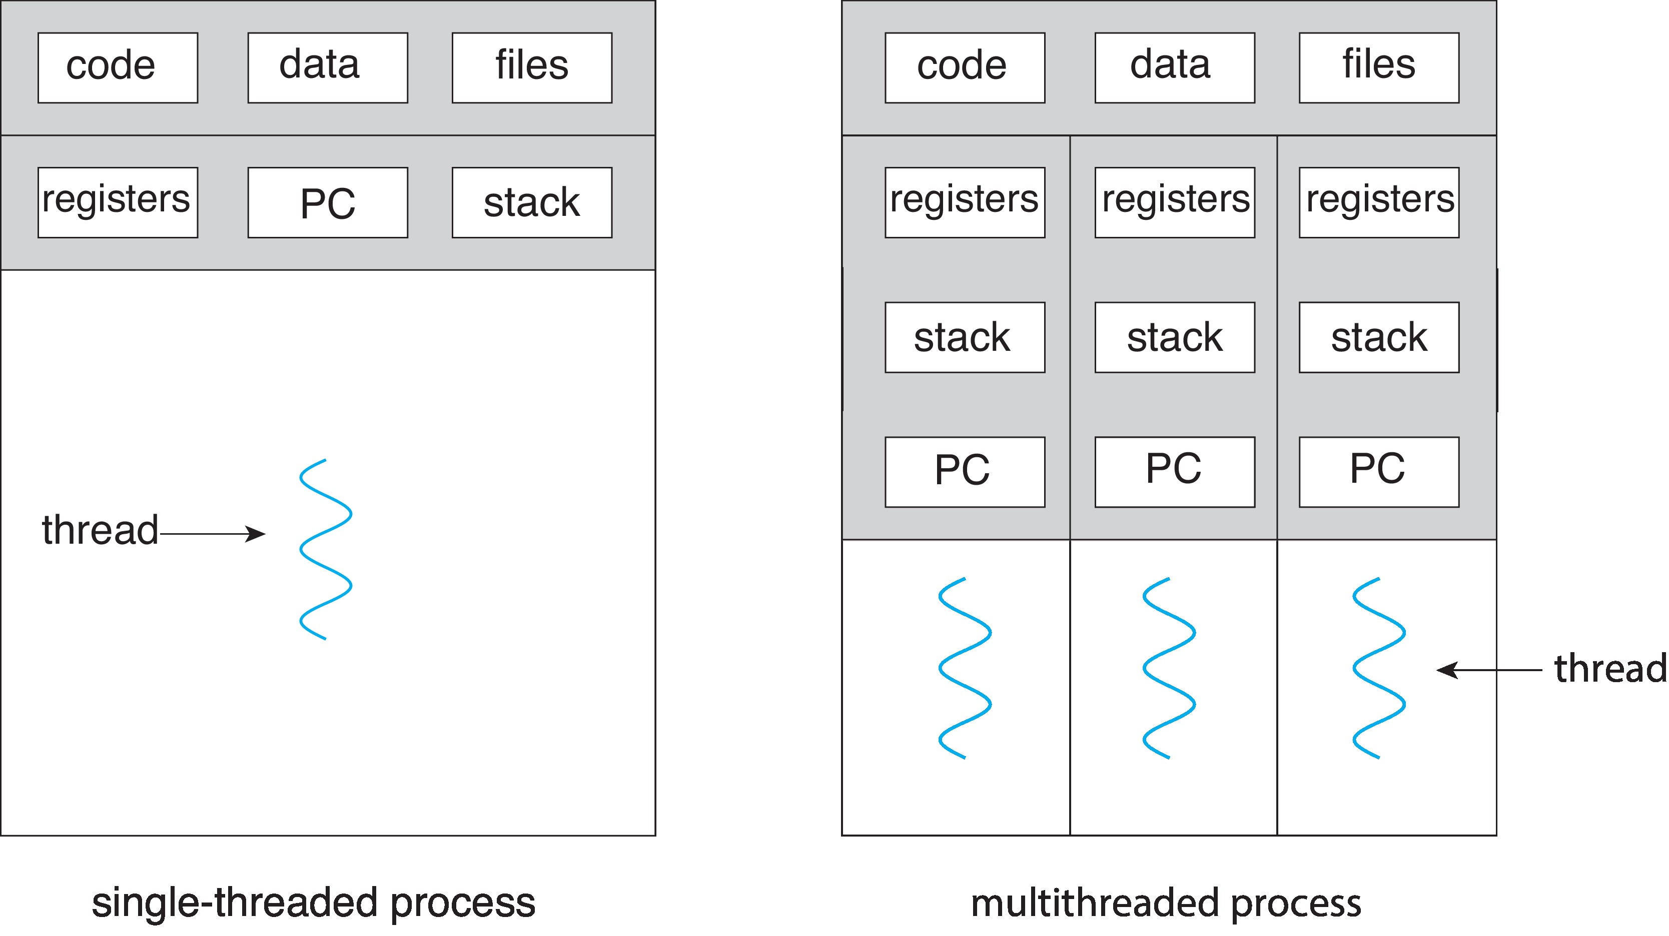
Single and Multithreaded Processes
Notes:
- Ortak veri alanı (data and heap segments) olan proseslere thread denir.

Slide 6
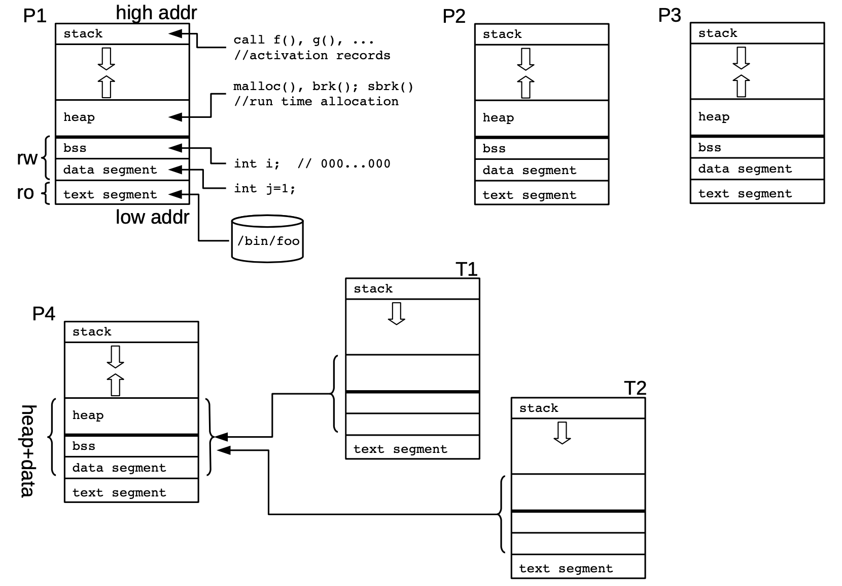
Threads vs. Process
Kaynak : Linux altında Sistem Programlama Lab. Çalışması Notları, Nazım Koç, http://UCanLinux.Com
Notes:
- Ş̧ekilde 4 adet proses vardır. Her prosesin bütün segmentleri bağımsızdır.
P4, T1 ve T2 ile gösterilen, 2 adet thread oluşturmuş.
P4 ile T1 ve T2’nin data ve heap alanları paylaşımlıdır, ortaktır.

Slide 7
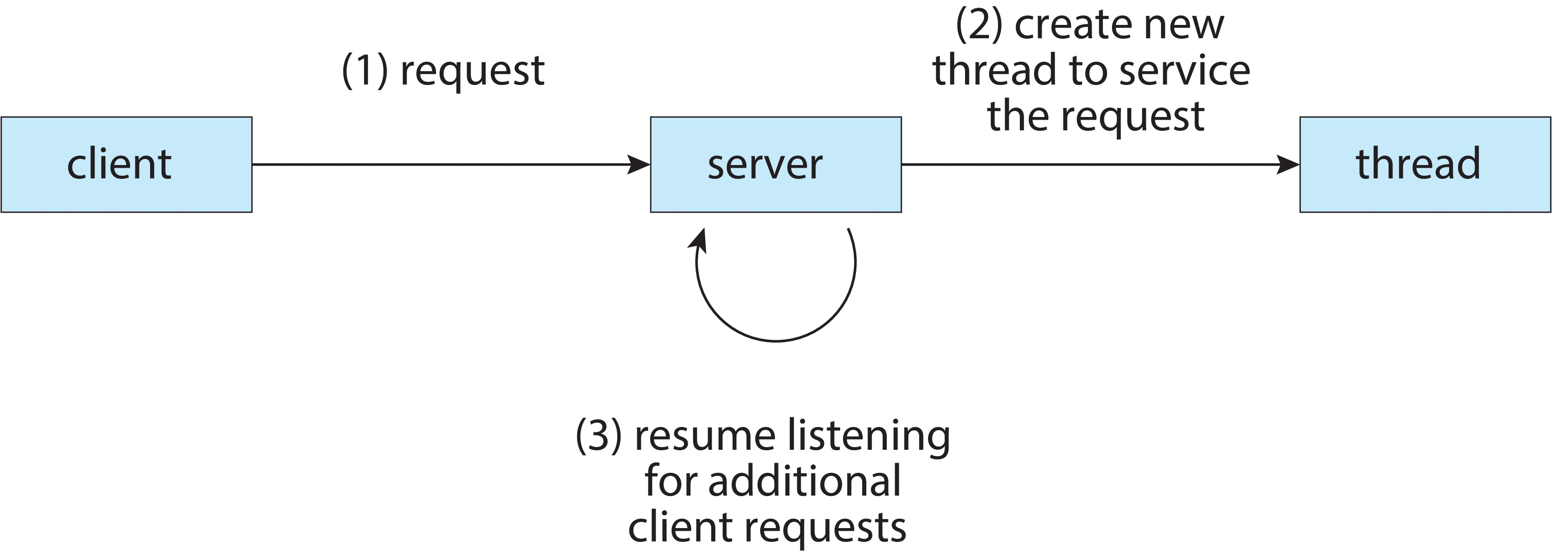
Multithreaded Server Architecture

Slide 8
Benefits
Responsiveness – may allow continued execution if part of process is blocked, especially important for user interfaces
Resource Sharing – threads share resources of process, easier than shared memory or message passing
Economy – cheaper than process creation, thread switching lower overhead than context switching
Scalability – process can take advantage of multicore architectures

Slide 9
Multicore Programming
Multicore or multiprocessor systems putting pressure on programmers, challenges include:
  Dividing activities
  Balance
  Data splitting
  Data dependency
  Testing and debugging
Parallelism implies a system can perform more than one task simultaneously
Concurrency supports more than one task making progress
  Single processor / core, scheduler providing concurrency

Slide 10
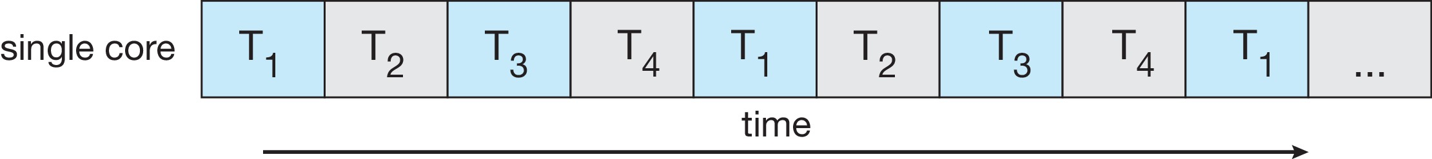
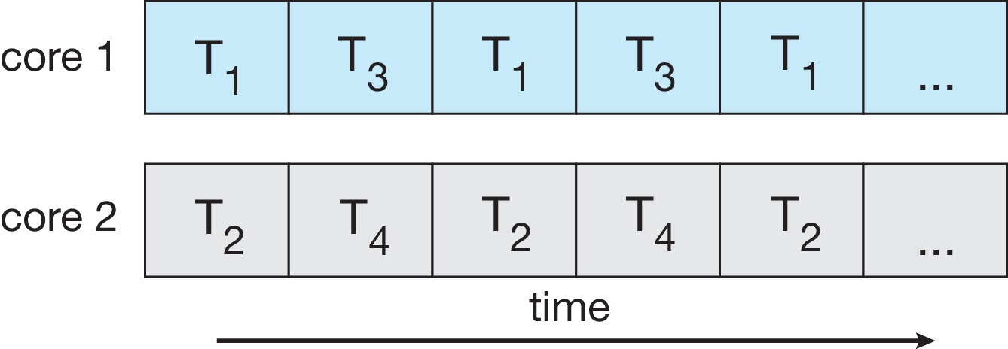
Concurrency vs. Parallelism
Concurrent execution on single-core system:
Parallelism on a multi-core system:

Slide 11
Multicore Programming
Types of parallelism
  Data parallelism – distributes subsets of the same data across multiple cores, same operation on each
  Task parallelism – distributing threads across cores, each thread performing unique operation

Slide 12
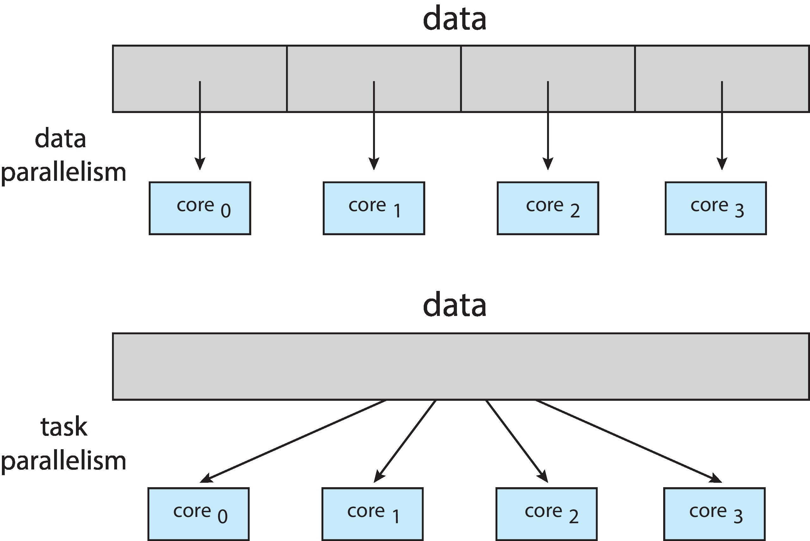
Data and Task Parallelism

Slide 13

Amdahl’s Law
Identifies performance gains from adding additional cores to an application that has both serial and parallel components
S is serial portion
N processing cores
That is, if application is 75% parallel / 25% serial, moving from 1 to 2 cores results in speedup of 1.6 times
1 / (0.25 + (0.75/2)) = 1.6
As N approaches infinity, speedup approaches 1 / S
Serial portion of an application has disproportionate effect on performance gained by adding additional cores
But does the law take into account contemporary multicore systems?
Notes:
In general terms, Amdahl’s Law states that in parallelization, if P is the proportion of a system or program that can be made parallel, and 1-P is the proportion that remains serial, then the maximum speedup S(N) that can be achieved using N processors is:
S(N)=1/((1-P)+(P/N))
As N grows the speedup tends to 1/(1-P).
Tek çekirdek iki çekirdeğe çıkarsa hız artışı : 1 / (0.25 + (0.75/2)) = 1.6

Slide 14
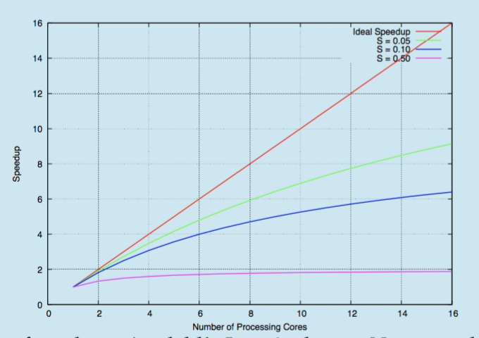
Amdahl’s Law

Slide 15
User Threads and Kernel Threads
User threads - management done by user-level threads library
Three primary thread libraries:
  POSIX Pthreads
  Windows threads
  Java threads
Kernel threads - Supported by the Kernel
Examples – virtually all general-purpose operating systems, including:
  Windows
  Linux
  Mac OS X
  iOS
  Android

Slide 16
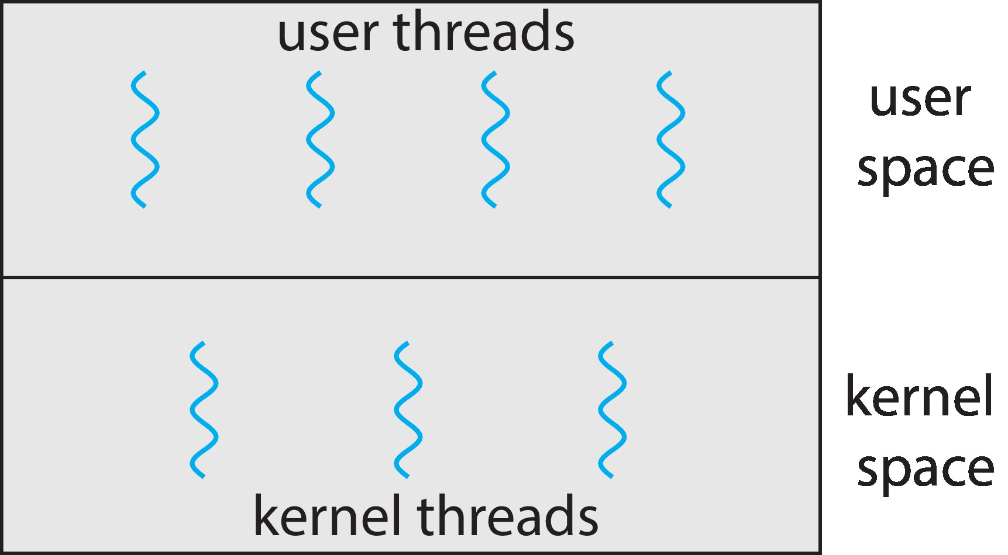
User and Kernel Threads

Slide 17
End of Chapter 4

